Slide 1

Submitted to:
Deepti Mam
(Bootcamp Trainer)

Slide 2
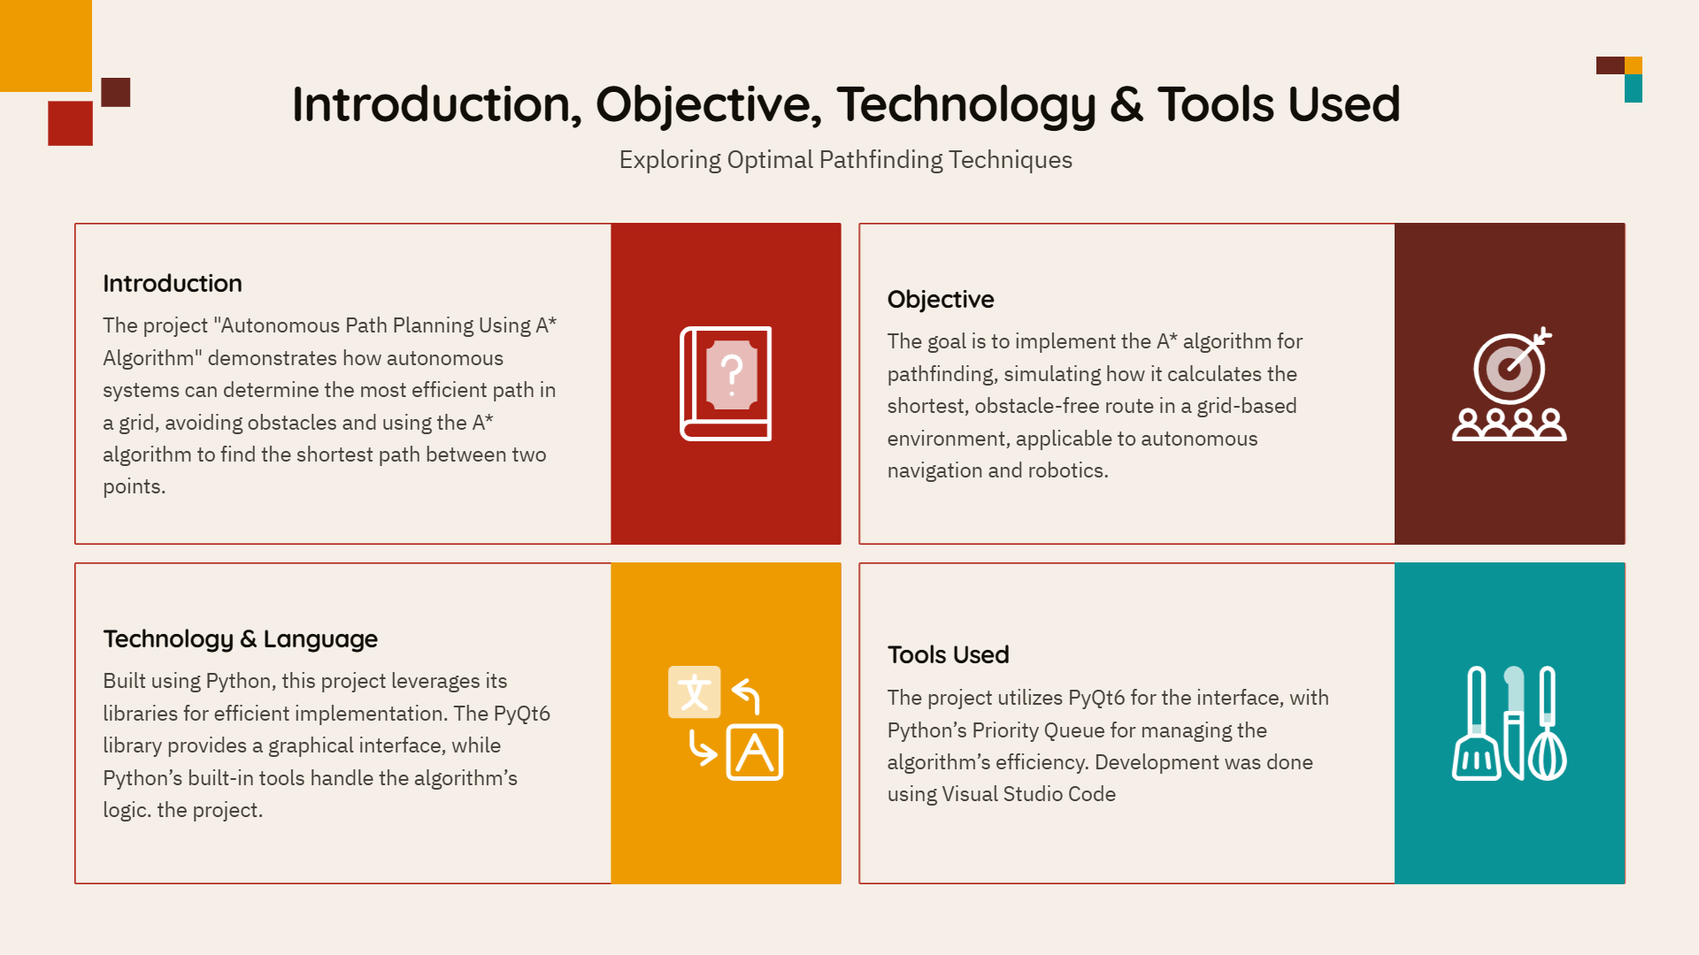

Slide 3

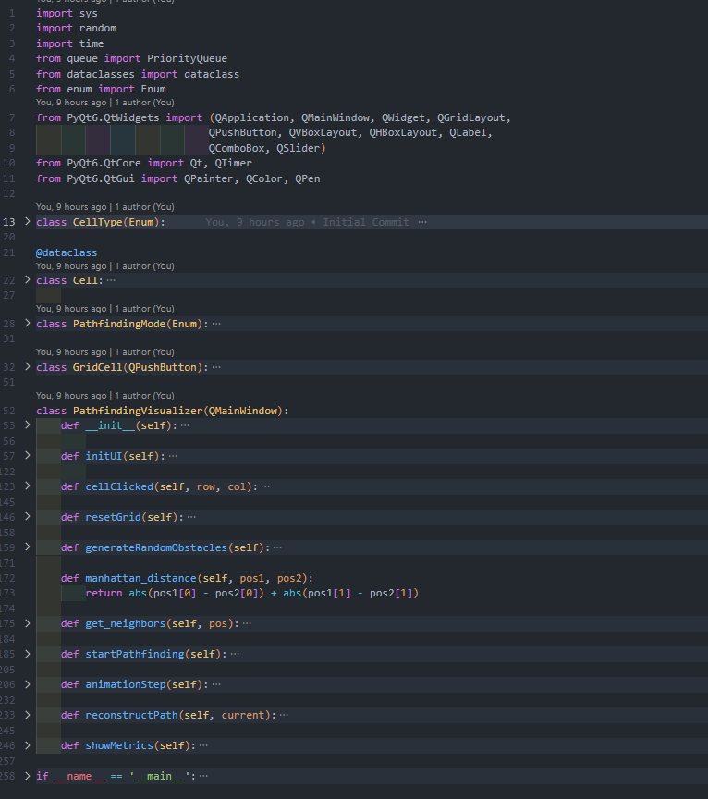
CODE

Slide 4
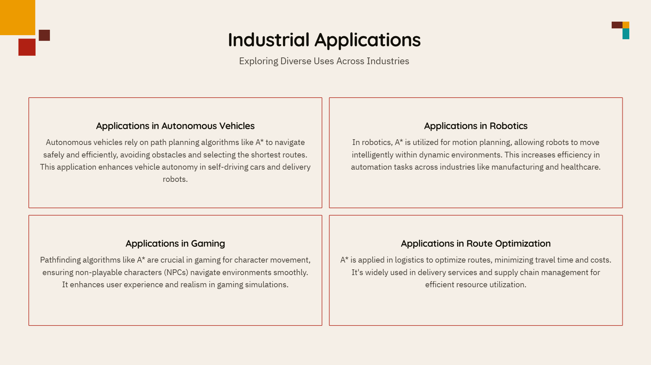

Slide 5
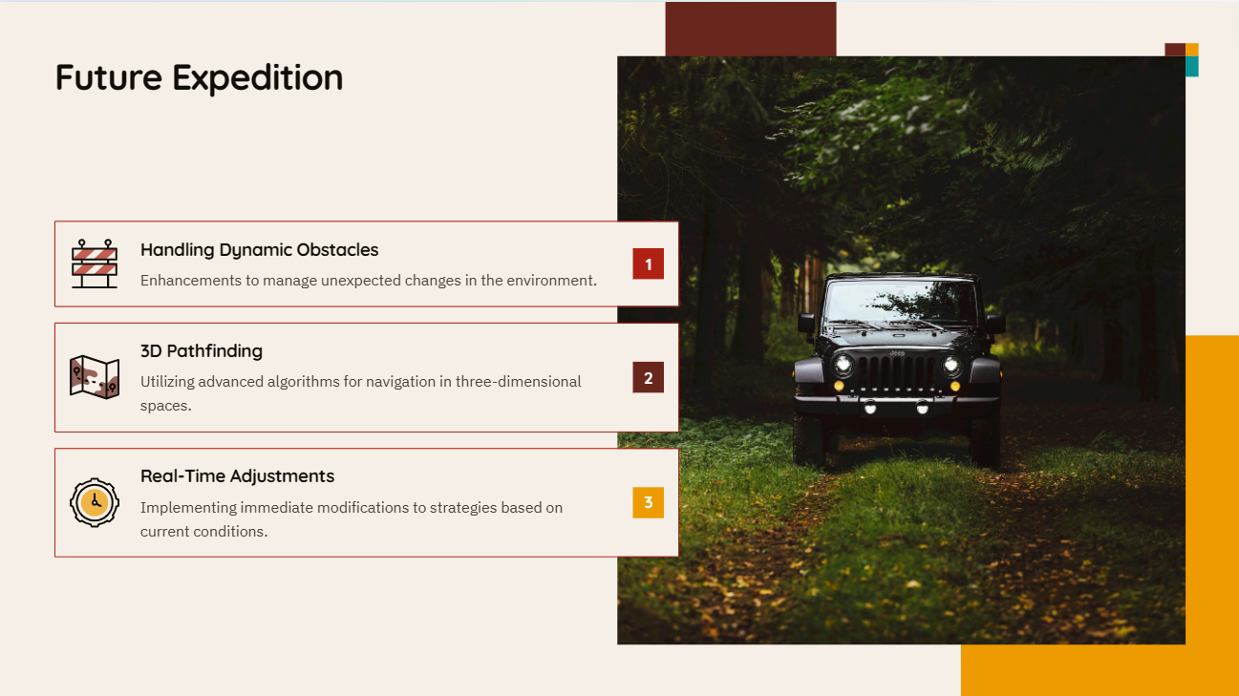

Slide 6


Slide 7


